Slide 1
Certification of Hydrogen Role of auditor
Jorn Bronsvoort
QS Testing • Inspection • Certification
19 October 2022
TRUSTED QUALITY SERVICES

Slide 2
Agenda workshop
Introduction QS
Auditor tasks
What is a RED-II RFNBO certificate?
Difference between types of audits
Audit costs (fee to the auditor)

Slide 3
Introduction QS
Independent services for:
Testing
Inspection & Verification
Certification
Focus on Environment & Energy markets
Our services include:
Better Biomass – NTA 8080 certification
ISCC EU and ISCC Plus certification
Dutch “SMK Milieukeur Groene Elektriciteit” program
Inspection of biomethane installations for GoO registration in NL
Verification for Dutch Double Counting
Verification for Dutch REV system for HBE registration
Part of Normec Group since 2021
Role as auditor in Dutch RVO pilot for RFNBO certification

Slide 4
Auditor tasks (1)
General auditor principles:
Auditor conducts audit on behalf of Certification Body
Independent from auditee & company to be audited
Has required competences and qualifications
Responsible for performing the audit according relevant scheme requirements
No consultant / No advice
Auditor will not make your mass balance or GHG calculation, only verify it!

Slide 5
Auditor tasks (2)
Preparation of audit (e.g. desk study of documents and GHG calculation)
Carry out risk evaluation / risk assessment
Perform on-site audit to check:
QMS with handbook, procedures and critical control points in place
Physical installation, infrastructure and metering
Traceability documents (incoming / outgoing incl. contracts)*
Mass Balance documents (incl. production reports)*
GHG calculation, including:
Used calculation methodology
Verification of used emission factors
Verification of input variables
Examination of outcomes (minimum reduction requirement)
Reporting of audit results and follow-up of non-conformities
* based on a sampling principle with sample size based on risk assessment

Slide 6
What is a RED-II RFNBO certificate?
Certificate issued by Certification Body according specific certification scheme
Certification scheme recognized by European Commission for RED-II scope
Issued on company / organization level with specified validity (e.g. 1 year)
Certificate proofs that companies processes and administration comply with the requirements and is able to deliver RED-II compliant RFNBO product
Certificate does NOT include amounts or volumes
Certificate gives certified company itself the right to issue Sustainability Declaration (PoS) for batches RFNBO product that comply with requirements
Important notes:
RED-II RFNBO certificate is not a Guarantee of Origin as mentioned in RED-II
Existing CertifHy system is using a different principle of certification

Slide 7
Difference between types of audits
General types of audits for RED-II recognized certification schemes:
Important notes;
Example based on validity of 1 year, can be longer for some systems, but always yearly audit
A pre-audit may be possible before the official initial audit, but not described in schemes
Existing CertifHy system using different principle of auditing with verification per batch
Type of audit | What | Focus during audit | When
Initial audit | Official examination | Initial process, procedures and documents in place | Before issue 1st certificate
Surveillance audit | Interim examination | Volumes of first 6 months | Within 6 months after issue date 1st certificate
1st Re-certification audit | Official re-examination | Actualized process, procedures and documents in place + volumes of 1st year | Before end of validity period 1st certificate
2nd Re-certification audit | Official re-examination | Actualized process, procedures and documents in place + volumes of 2nd year | Before end of validity period 2nd certificate

Slide 8
Audit costs (fee to the auditor)
Indication of fees for auditor:
Important notes:
Fee depending from size and complexity of company, process and installation
Based on typical auditor day rate of EUR 1.500,-
Excluding fees for certification scheme
Excluding travelling costs
Type of audit | Range of costs (EUR)
Initial audit | 3.000 – 7.500
Surveillance audit (only 1st year) | 1.500 – 3.000
Re-certification audit | 3.000 – 7.500

Slide 9
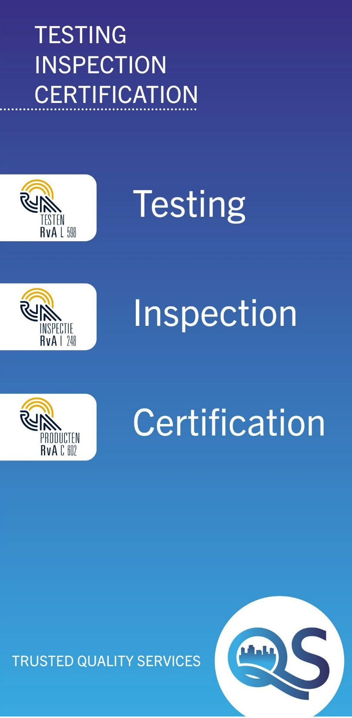
+31(0)88-166 2000 www.qsbv.com info@qsbv.com or bronsvoort@qsbv.com
Questions?
36/36 4 juni 2015

